Slide 1





Planning-oriented Autonomous Driving
CVPR 2023
By Yihan Hu* Jiazhi Yang* Li Chen*+ Keyu Li*
Seminar AI4AD
Presented by Camilo Martínez
Advances in AI for Autonomous Driving
1

Slide 2
II
I
III
IV
V
I
II
I
III
Table of Contents
IV
1. Motivation
2. Methodology
3. Experiment & Results
4. Limitations
5. Conclusions
II
V
III
IV
V
2

Slide 3
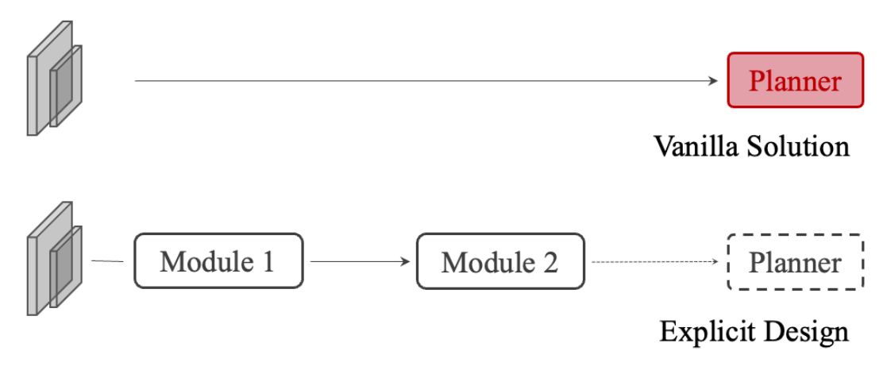
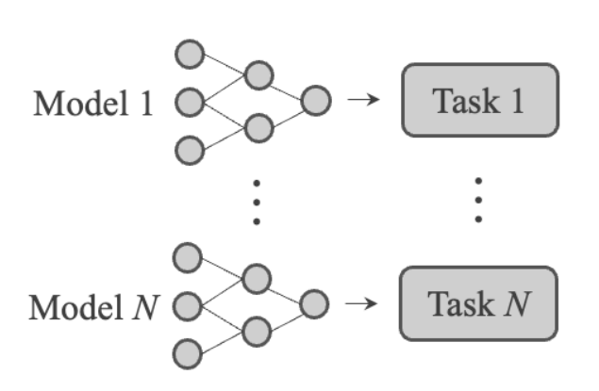
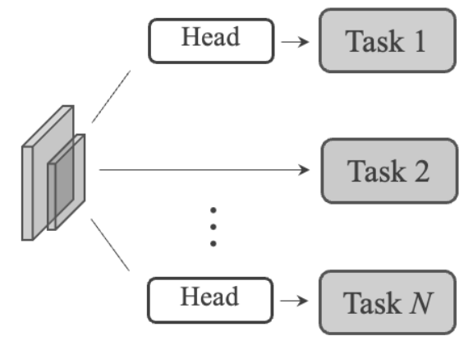
Motivation
3
End-to-End Systems
1
Standalone Models
They unite perception, prediction and planning as a whole.
They bare the risk of
information loss
error accumulation
feature misalignment
2
Multi-Task Learning
May cause undesirable
“negative transfer”.
3
Notes:
Onboard chip resources allow. Simplifies R&D difficulty.
Isolated Optimization Objective per task
Object Detection: mAP
Motion Prediction: minFDE

Slide 4
Motivation
3
End-to-End Systems
1
Standalone Models
They unite perception, prediction and planning as a whole.
They bare the risk of
information loss
error accumulation
feature misalignment
2
Multi-Task Learning
May cause undesirable
“negative transfer”.
4
Notes:
Shared feature for multiple tasks
Easily extended to more tasks, compute-efficient
Lack of tasks’ coordination

Slide 5
Motivation
3
End-to-End Systems
1
Standalone Models
They unite perception, prediction and planning as a whole.
They bare the risk of
information loss
error accumulation
feature misalignment
2
Multi-Task Learning
May cause undesirable
“negative transfer”.
5
Notes:
Direct policy learning from sensor inputs, bypassing intermediate tasks
Simple design with good performance in the simulator
Deficient in interpretability
The choice and priority of preceding tasks should be determined in favor of planning

Slide 6
Which Tasks?
AD Tasks
Safe Planning
Perception
Prediction
Track Agents Behavior
Object Detection
Object Tracking
Semantic Segmentation
Online Mapping
Depth Estimation
Traffic light/sign Detection
…
Motion Forecasting
Intention Prediction
Occupancy Prediction
…
Environment Interaction
Map (lane) Guidance
Find free space
Upper-level
Medium-level
Low-level
6

Slide 7
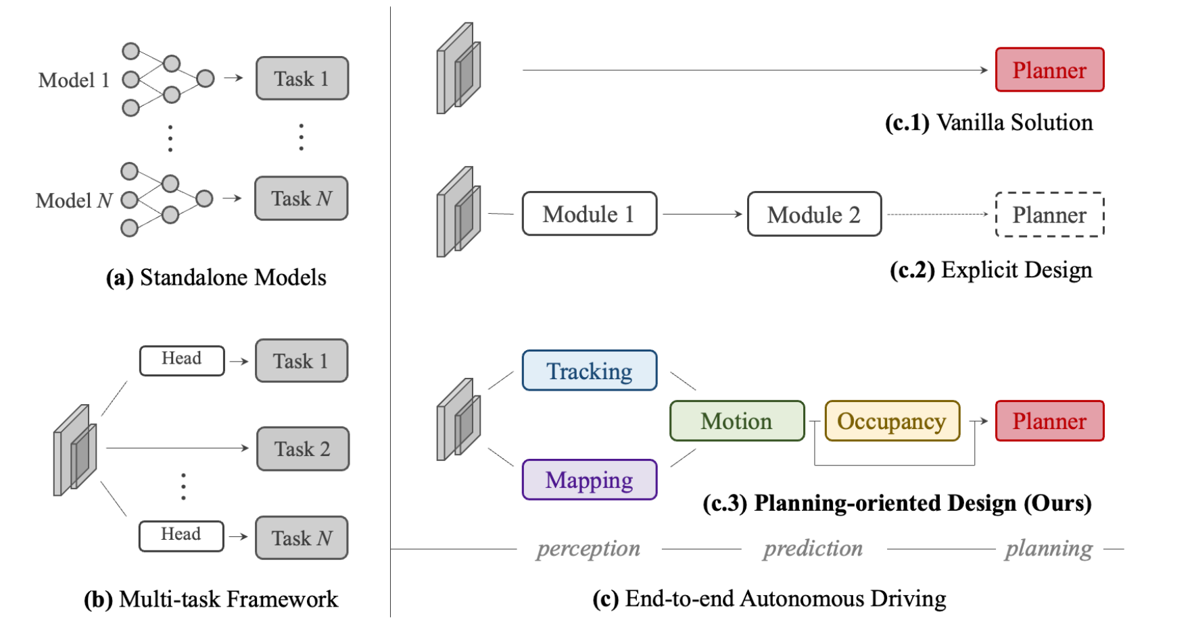
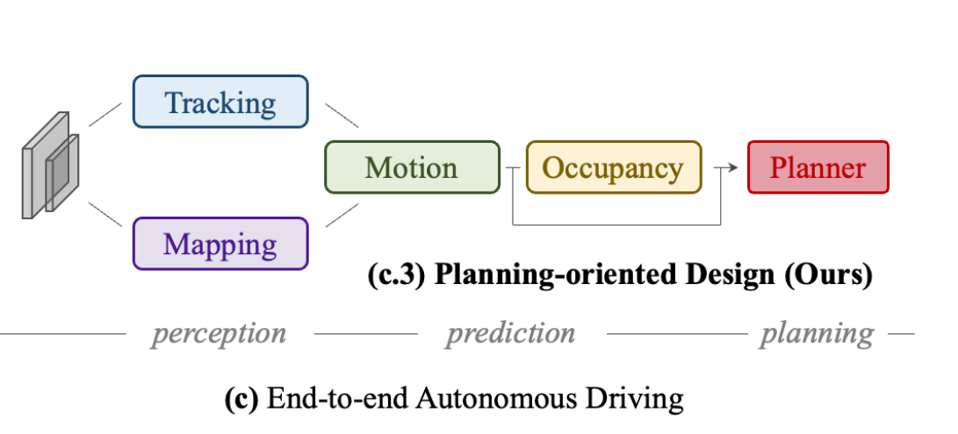
The UniAD
Track Agents Behavior
Object Detection, Object Tracking, Online Mapping
Perception
Guide with lanes
Unify full-stack AD tasks
Motion Forecasting, Occupancy Prediction, Find free space
Environment Interaction
Prediction
GOALS
Planning
Coordinate all task towards
safe planning
7

Slide 8
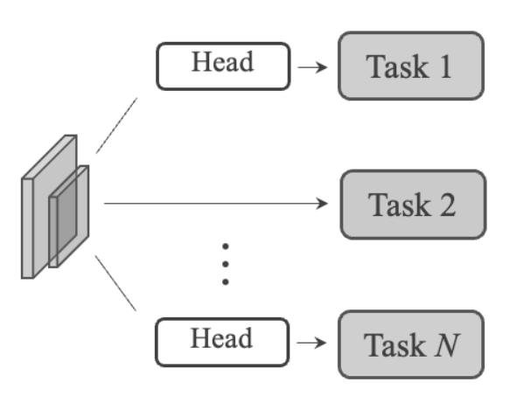
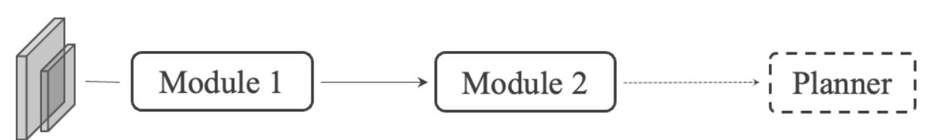
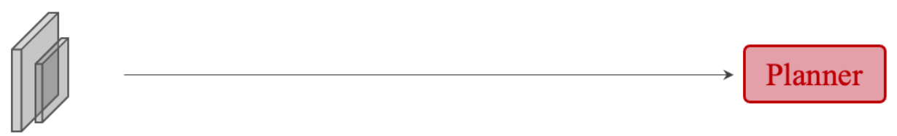
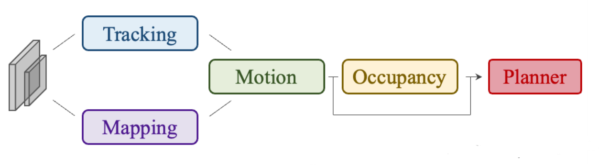
Tasks Comparison & Taxonomy
DESIGN | APPROACH | WORK | PERCEPTION |  |  | PREDICTION |  | PLAN
 |  |  | Detect | Track | Map | Motion | Occup.
Multi-task Framework | NMP | CVPR 2019 | ✔ |  |  | ✔ |  | ✔
 | NEAT | ICCV 2021 |  |  | ✔ |  |  | ✔
 | BEVerse | 2022 | ✔ |  | ✔ |  | ✔
Explicit Design | PnPNet | CVPR 2020 | ✔ | ✔ |  | ✔
 | ViP3D | CVPR 2023 | ✔ | ✔ |  | ✔
 | P3 | ECCV 2020 |  |  |  |  | ✔ | ✔
 | MP3 | CVPR 2021 |  |  | ✔ |  | ✔ | ✔
 | ST-P3 | ECCV 2022 |  |  | ✔ |  | ✔ | ✔
 | LAV | CVPR 2022 | ✔ |  | ✔ | ✔ |  | ✔
Vanilla Solution | [7, 9, 45, 54] | 2020-2022 |  |  |  |  |  | ✔
Planning Oriented Design | UniAD | CVPR 2023 | ✔ | ✔ | ✔ | ✔ | ✔ | ✔
8

Slide 9
II
I
III
IV
V
I
II
I
III
Table of Contents
IV
1. Motivation
2. Methodology
3. Experiment & Results
4. Limitations
5. Conclusions
II
V
III
IV
V
9

Slide 10
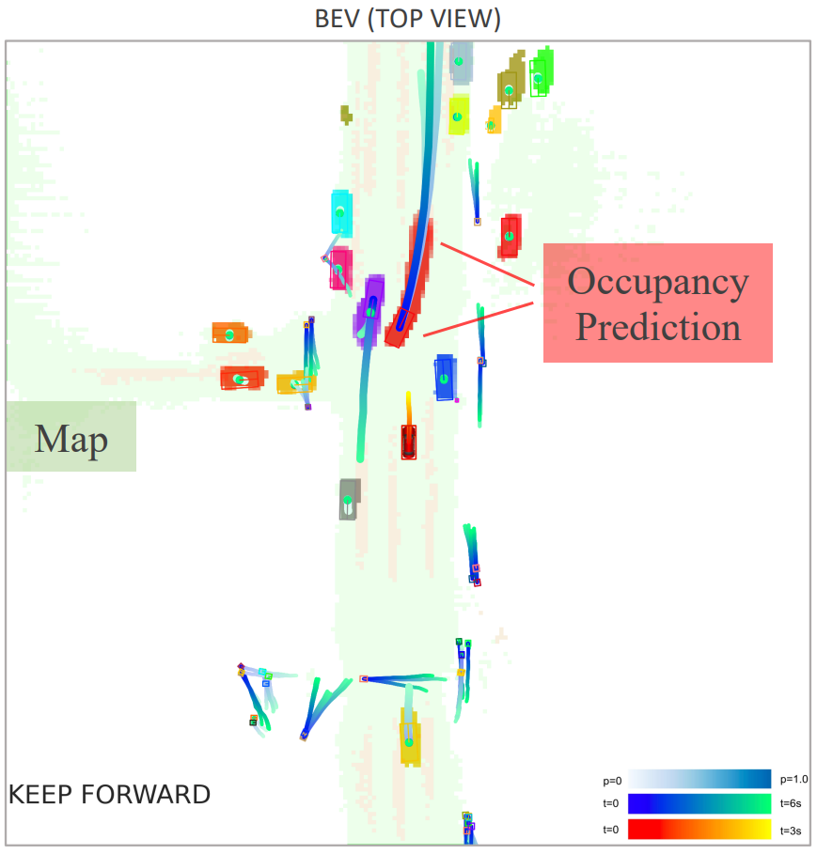
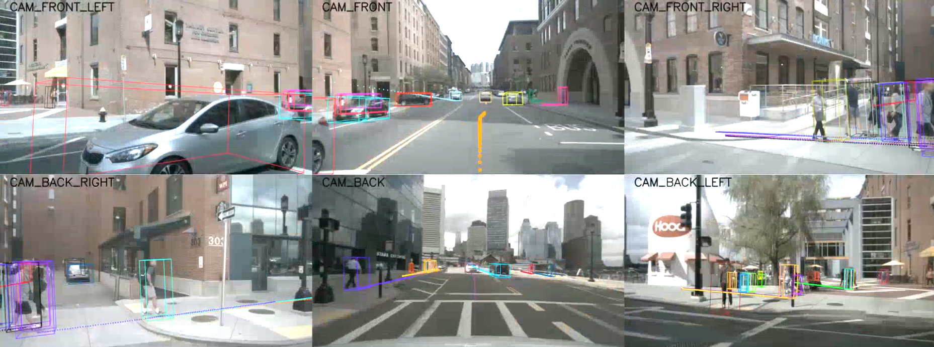
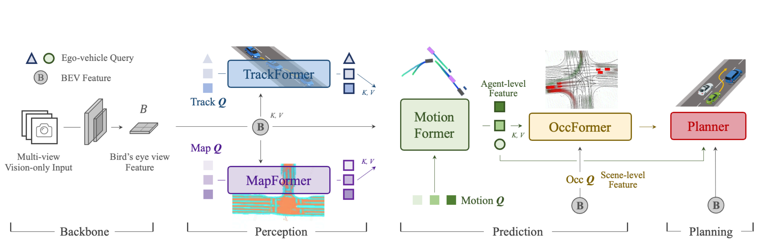
The UniAD Pipeline
Perception
Prediction
Planning
Planned final trajectory
Avoid collision
Tasks coordinated with queries
Interactions modelled by attention
Transformer-based
Track agents across time
Predict long-term trajectory
Segment map elements
Scene-level representation
Unified Query
10

Slide 11
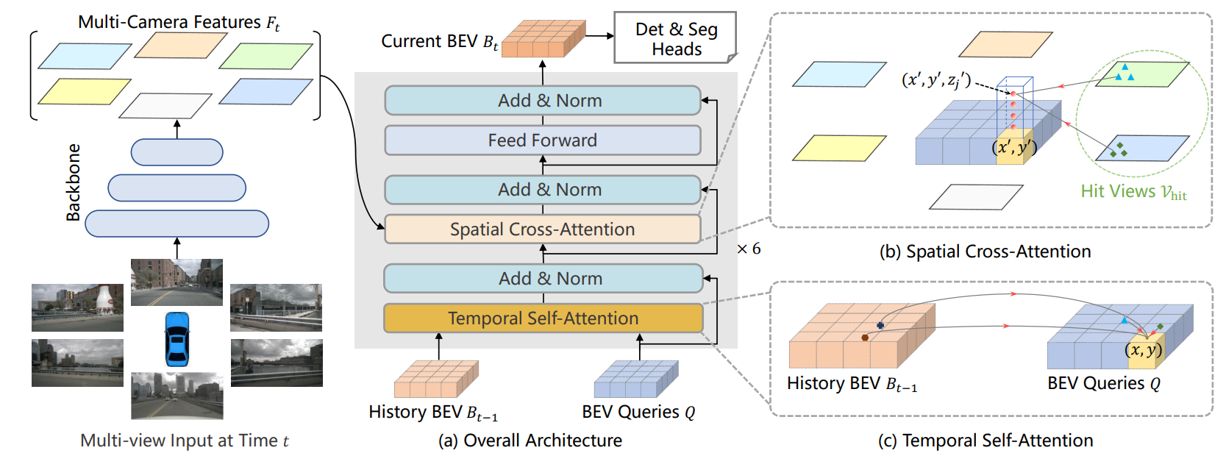
Perception
Prediction
Planning
The UniAD Pipeline
INPUT
A sequence of multi-camera images are transformed into a unified bird’s-eye-view (BEV) feature by BEVFormer.
BEV Encoder – BEVFormer (ECCV 2022)
ADVANTAGES
Strong BEV encoder with effective spatial and temporal feature extraction.
Not really part of the main pipeline of UniAD, that is, it’s not confined to this one specifically.
11
Notes:
One can utilize other alternatives to extract richer BEV representations with long-term temporal fusion or multi-modality fusion.

Slide 12
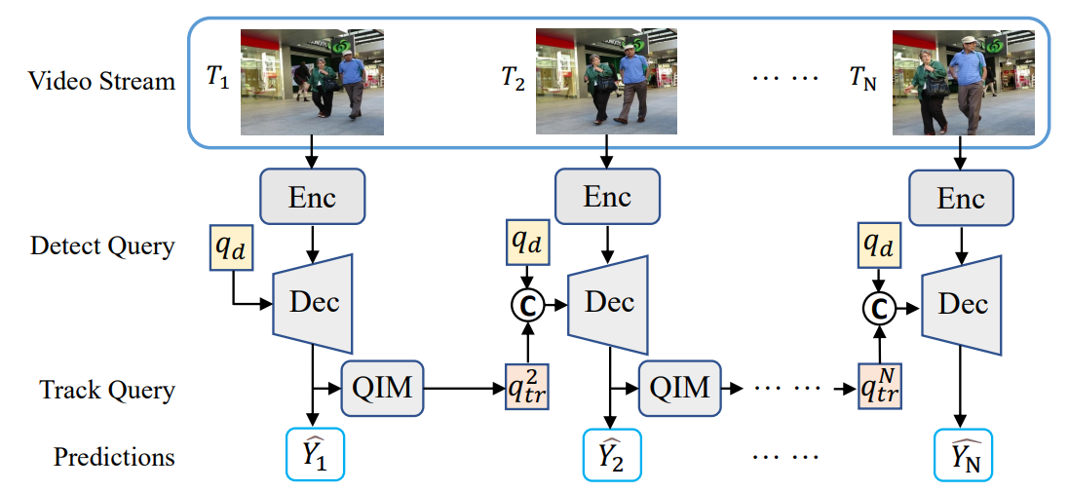
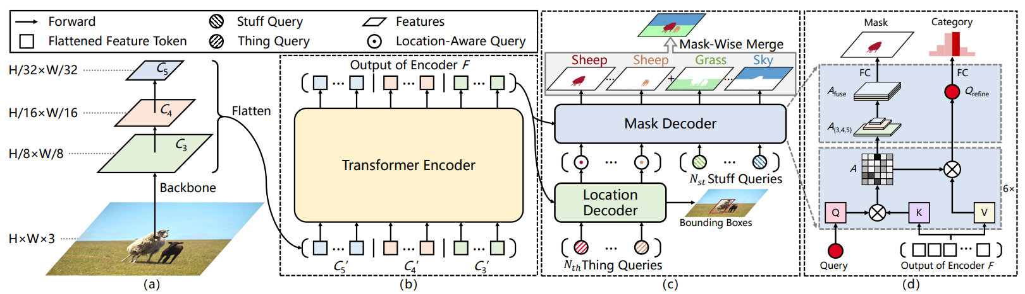
Perception
Prediction
Planning
The UniAD Pipeline
MOTR (ECCV 2022)
End-to-end Multiple Object Tracking without post-association.
Road elements are represented as map queries.
Panoptic SegFormer (CVPR 2022)
12
Notes:
One can utilize other alternatives to extract richer BEV representations with long-term temporal fusion or multi-modality fusion.

Slide 13
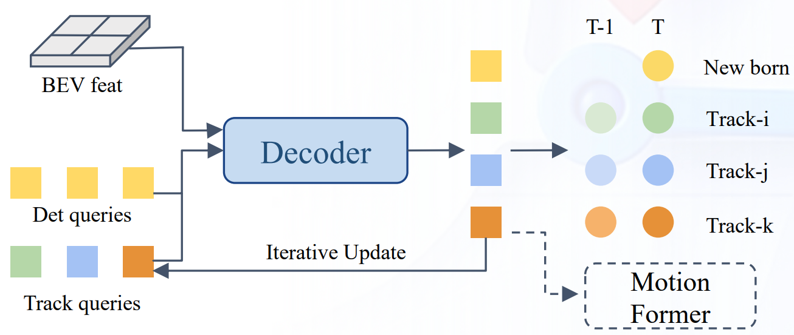


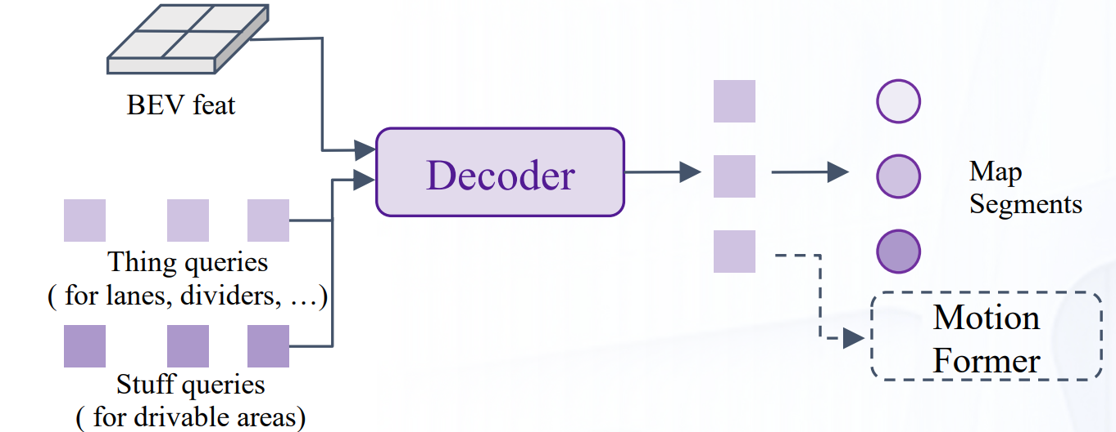
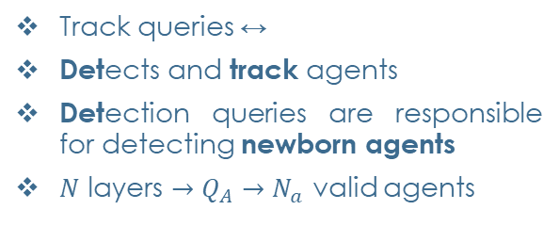
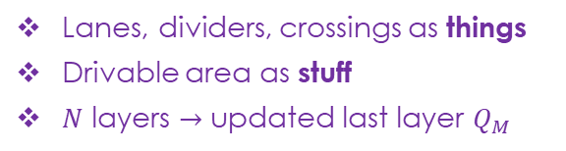
Perception
Prediction
Planning
The UniAD Pipeline
MOTR (ECCV 2022)
End-to-end Multiple Object Tracking without post-association
Track queries ↔
Detects and track agents
Detection queries are responsible for detecting newborn agents
$N$ layers $→Q_{A}→N_{a}$ valid agents
agents’ information
+
Road elements are represented as map queries.
Lanes, dividers, crossings as things
Drivable area as stuff
$N$ layers $→$ updated last layer $Q_{M}$
Panoptic SegFormer (CVPR 2022)
13
Notes:
At each time step, initialized detection queries are responsible for detecting newborn agents that are perceived for the first time, while track queries keep modeling those agents detected in previous frames.
Both detection queries and track queries capture the agent abstractions by attending to BEV feature B.
Track queries at the current frame interact with previously recorded ones in a self-attention module to aggregate temporal information, until the corresponding agents disappear completely (untracked in a certain time period).

Slide 14
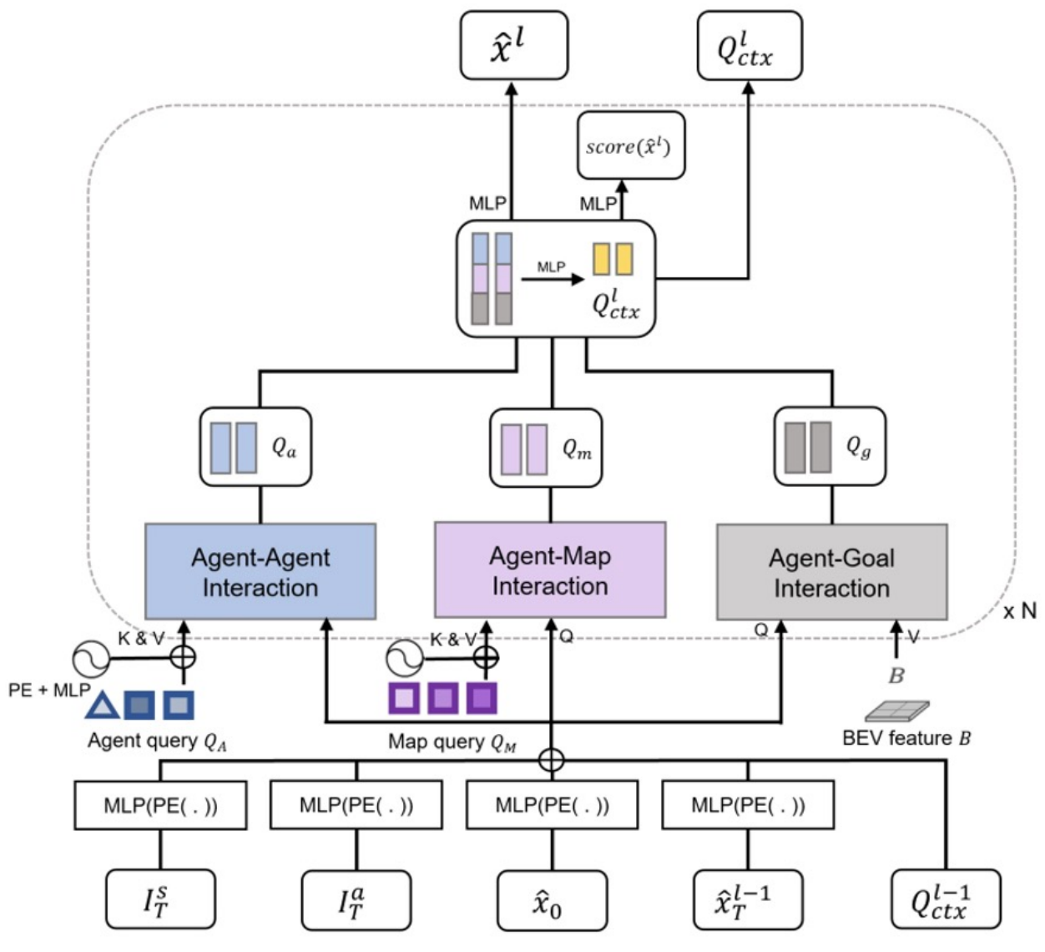
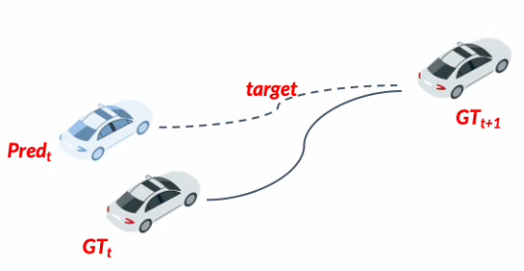
Perception
Prediction
Planning
The UniAD Pipeline
Proposed in UniAD
NON-LINEAR OPTIMIZATION
Adjust ground-truth trajectory based on upstream prediction.
Diverse relation modelings via attention mechanism:
agent-agent, agent-map, agent-goal
14
Notes:
It is composed of N layers, and each layer captures three types of interactions: agent-agent, agent-map and agent-goal point

Slide 15


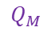

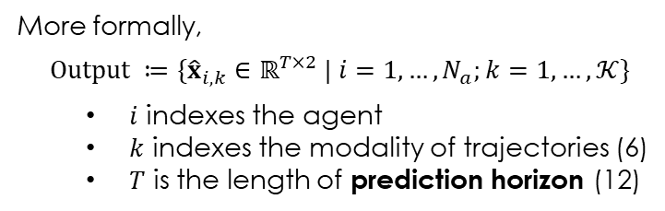
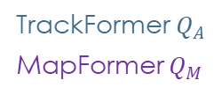

Perception
Prediction
Planning
The UniAD Pipeline
Proposed in UniAD
TrackFormer $Q_{A}$
MapFormer $Q_{M}$
Top-k possible trajectories
MotionFormer
$N$ layers
Multi-agent trajectories in the frame with a single forward pass
Ego-vehicle query interacts with other agents (future dynamics)
$$Q_{A}$$
More formally,
$$Output ≔\{{\hat{x}}_{i,k}∈ℝ^{T×2} | i=1,…,N_{a};k=1,…,𝒦\}$$
$i$ indexes the agent
$k$ indexes the modality of trajectories (6)
$T$ is the length of prediction horizon (12)
$$Q_{M}$$
15
Notes:
Dynamic agents Q_A and static map queries Q_M
Scene-centric manner.

Slide 16
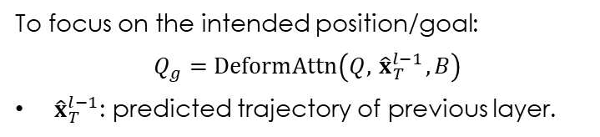

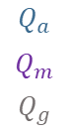
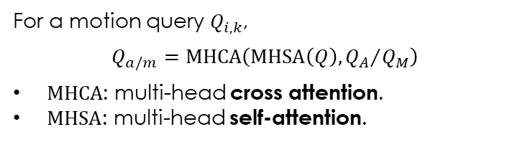
Perception
Prediction
Planning
The UniAD Pipeline
Proposed in UniAD
agent-agent, agent-map
For a motion query $Q_{i,k}$,
$$Q_{a/m}=MHCA\left(MHSA\left(Q\right),{Q_{A}}/{Q_{M}}\right)$$
$MHCA$: multi-head cross attention.
$MHSA$: multi-head self-attention.
agent-goal
$$Q_{A}$$
To focus on the intended position/goal:
$$Q_{g}=DeformAttn\left(Q,{ \hat{x}}_{T}^{l−1},B\right)$$
${\hat{x}}_{T}^{l−1}$: predicted trajectory of previous layer.
$$Q_{M}$$
$$Q_{a}$$
$$Q_{m}$$
$$Q_{g}$$
MLP
$$Q_{ctx}$$
Last layer output
16
Notes:
Q_i,k (omitting subscripts i, k for simplicity), its interactions between other agents Q_A or map elements Q_M could be formulated as shown.
Through deformable attention, the predicted trajectory is further refined as aware of the endpoint surroundings.

Slide 17
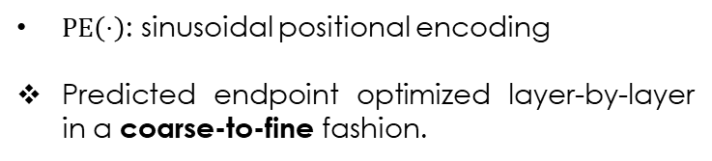
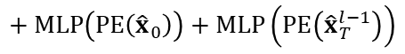
Perception
Prediction
Planning
The UniAD Pipeline
Proposed in UniAD
Motion Queries: $Q_{ctx} \left(previous layer\right)+Q_{pos}$
$$Q_{pos}=MLP\left(PE\left(I^{s}\right)\right)+MLP\left(PE\left(I^{a}\right)\right)$$
Scene-level anchors
Agent-level anchors
$$Q_{A}$$
$$+ MLP\left(PE\left({\hat{x}}_{0}\right)\right)+MLP\left(PE\left({\hat{x}}_{T}^{l−1}\right)\right)$$
Current location
Predicted goal point
$PE\left(⋅\right)$: sinusoidal positional encoding
Predicted endpoint optimized layer-by-layer in a coarse-to-fine fashion.
$$Q_{M}$$
17
Notes:
Scene-level anchors are prior movement statistics in a global view.
Agent-level anchor is the possible intention in a local view.

Slide 18

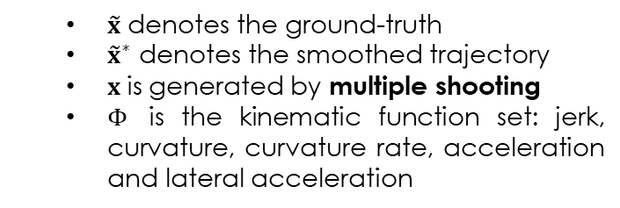
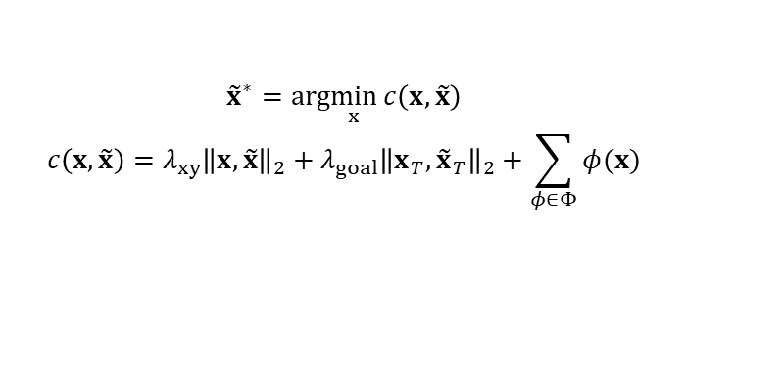
Perception
Prediction
Planning
The UniAD Pipeline
Proposed in UniAD
Tackle prediction uncertainty
Imperfect detection
Unrealistic trajectories
regression
Large curvature
Ground-truth waypoints
Large acceleration
$$Q_{A}$$
Instead, make them physically feasible given an imprecise starting point predicted by the upstream module:
$${\tilde{x}}^{∗}=arg\min_{x}{c\left(x,\tilde{x}\right)}$$
$$c\left(x,\tilde{x}\right)=λ_{xy}{\left\|x,\tilde{x}\right\|}_{2}+λ_{goal}{\left\|x_{T},{\tilde{x}}_{T}\right\|}_{2}+\sum_{φ∈Φ}{φ(x)}$$
$$Q_{M}$$
$\tilde{x}$ denotes the ground-truth
${\tilde{x}}^{∗}$ denotes the smoothed trajectory
$x$is generated by multiple shooting
$Φ$ is the kinematic function set: jerk, curvature, curvature rate, acceleration and lateral acceleration
18
Notes:
The cost function regularizes the target trajectory to obey kinematic constraints.
This target trajectory optimization is only conducted in training and does not affect inference.

Slide 19
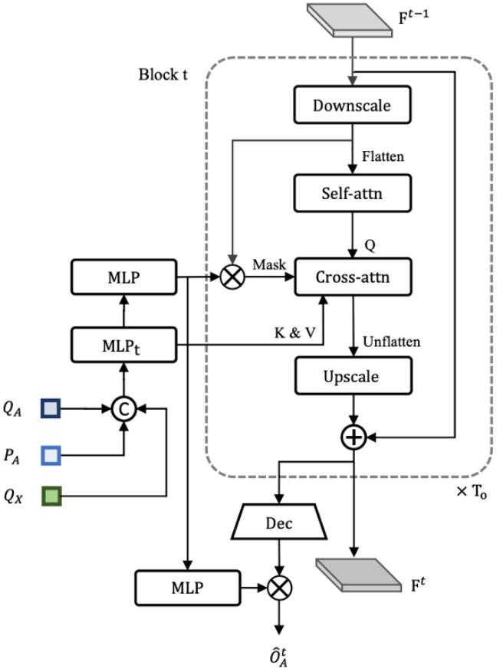
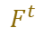

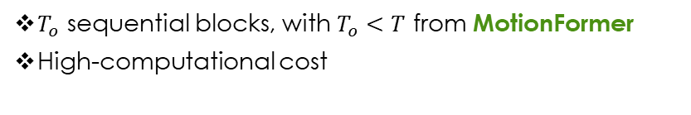
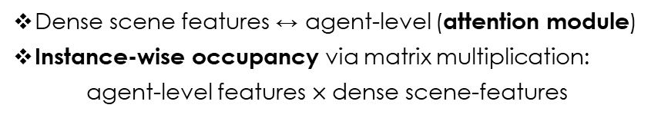

Perception
Prediction
Planning
The UniAD Pipeline
Proposed in UniAD
Occupancy prediction
Predict occupancy as attention mask
Encode agent-wise knowledge into the scene representation
Scene-level semantics
Agent-level semantics
Dense scene features ↔ agent-level (attention module)
Instance-wise occupancy via matrix multiplication:
agent-level features $×$dense scene-features
$T_{o}$ sequential blocks, with $T_{o}<T$ from MotionFormer
High-computational cost
Agent features $G^{t}$
OccFormer
$$F^{t}$$
State (dense feature) $F^{t−1}$
19
Notes:
Occupancy grid map is a discretized BEV representation where each cell holds a belief indicating whether it is occupied, and the occupancy prediction task is to discover how the grid map changes in the future.
Each block takes the rich agent features G^t and the state F from the previous layer, and generates F^t considering both instance- and scene-level information.

Slide 20
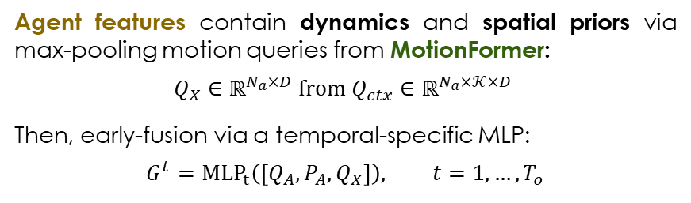



Perception
Prediction
Planning
The UniAD Pipeline
Proposed in UniAD
Agent features $G^{t}$
OccFormer
$$F^{t}$$
State (dense feature) $F^{t−1}$
Agent features contain dynamics and spatial priors via max-pooling motion queries from MotionFormer:
$$Q_{X}∈ℝ^{N_{a}×D} from Q_{ctx}∈ℝ^{N_{a}×𝒦×D}$$
Then, early-fusion via a temporal-specific MLP:
$$G^{t}={MLP}_{t}\left(\left[Q_{A}, P_{A}, Q_{X}\right]\right), t=1,…,T_{o}$$
$Q_{A}$: upstream track query
$P_{A}$: current position embedding
$\left[⋅\right]$: concatenation
State (dense feature) $F^{0}$ is the BEV feature ¼ downscaled
20
Notes:
Q_X is obtained by max-pooling from the modality dimension K

Slide 21
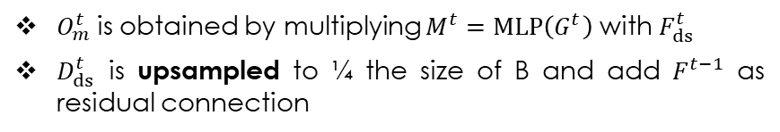
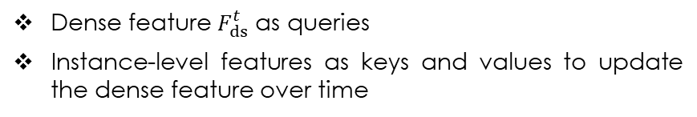
Perception
Prediction
Planning
The UniAD Pipeline
Proposed in UniAD
Scene
Agent-level understanding
Pixel-level interaction
Dense feature $F_{ds}^{t}$ as queries
Instance-level features as keys and values to update the dense feature over time
$$D_{ds}^{t}=MHCA\left(MHSA\left(F_{ds}^{t}\right),G^{t}, att_mask=O_{m}^{t}\right)$$
$O_{m}^{t}$is obtained by multiplying $M^{t}=MLP\left(G^{t}\right)$ with $F_{ds}^{t}$
$D_{ds}^{t}$ is upsampled to ¼ the size of B and add $F^{t−1}$ as residual connection
21
Notes:
Unify scene and agent-level interaction when predicting future occupancy
Restrict each pixel to only look at the agent occupying it at timestep t

Slide 22
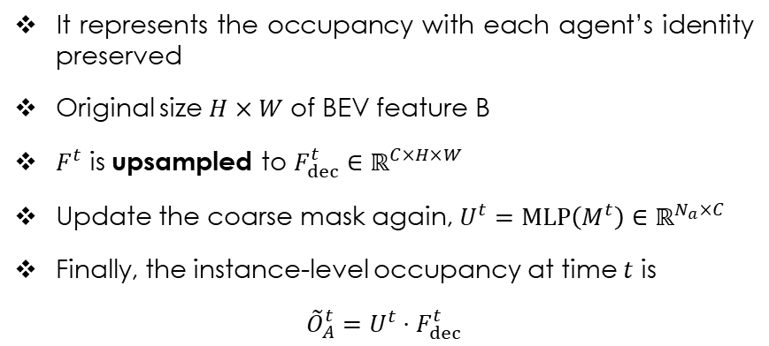
Perception
Prediction
Planning
The UniAD Pipeline
Proposed in UniAD
Instance-level occupancy
It represents the occupancy with each agent’s identity preserved
Original size $H×W$ of BEV feature B
$F^{t}$ is upsampled to $F_{dec}^{t}∈ℝ^{C×H×W}$
Update the coarse mask again, $U^{t}=MLP\left(M^{t}\right)∈ℝ^{N_{a}×C}$
Finally, the instance-level occupancy at time $t$ is
$${\tilde{O}}_{A}^{t}=U^{t}⋅F_{dec}^{t}$$
22
Notes:
Represents the occupancy with each agent’s identity identified
It could be simply via matrix multiplication

Slide 23

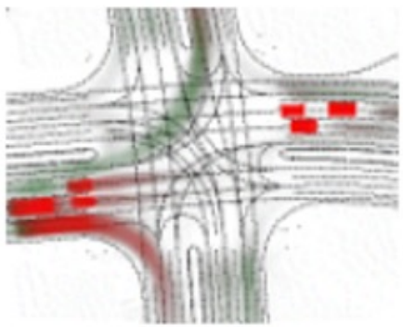

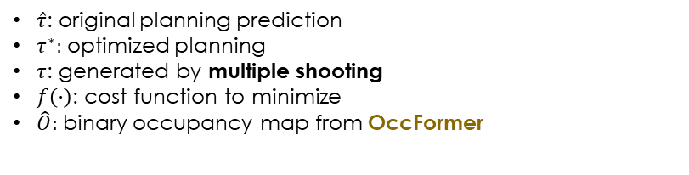

Perception
Prediction
Planning
The UniAD Pipeline
Proposed in UniAD
Planning
Ego-vehicle query consistently passed through TrackFormer, MotionFormer, and now Planner.
turn left
+
“plan query”
turn right
3 learnable embeddings
(command embeddings)
attend
$$\hat{τ}$$
↕
BEV Features B
forward
Avoid collisions through Newton’s method in inference
$$τ^{∗}=\arg{\min_{τ}{f\left(τ, \hat{τ}, \hat{O}\right)}}$$
$\hat{τ}$: original planning prediction
$τ^{∗}:$ optimized planning
$τ$: generated by multiple shooting
$f\left(⋅\right)$: cost function to minimize
$\hat{O}:$ binary occupancy map from OccFormer
23
Notes:
From the MotionFormer, the ego-vehicle already has multimodal intentions. Now we equip it with command embeddings to form a “plan query”.
We attend to BEV features to make it aware of surroundings and decode it to future waypoints tau.

Slide 24
Perception
Prediction
Planning
The UniAD Pipeline
Transformer-based
Unified Query
24
Notes:
One can utilize other alternatives to extract richer BEV representations with long-term temporal fusion or multi-modality fusion.

Slide 25
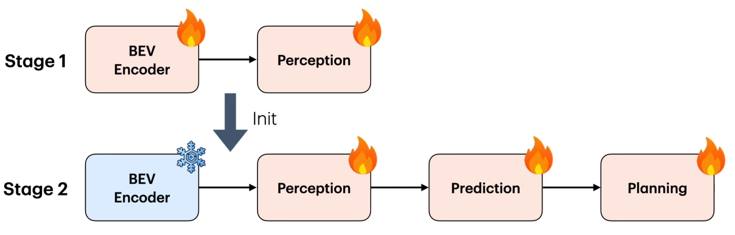
How to train it?
Two-phase training
Shared matching (Bipartite Matching Algorithm)
Perception stage + End-to-end stage
The stabilized perception capability helps the end-to-end stage converge faster
Inspired by DETR (DEtection TRansformer), which matches predictions to ground truth entities minimizing a cost function
Consistent learning of agent identities
Converges faster
Tracking and Mapping modules
6 epochs
End-to-end training
20 epochs
25
From: https://www.youtube.com/watch?v=GdEVfcLYpPc
Notes:
Matching results of tracking reused in motion and occupancy

Slide 26
II
I
III
IV
V
I
II
I
III
Table of Contents
IV
1. Motivation
2. Methodology
3. Experiment & Results
4. Limitations
5. Conclusions
II
V
III
IV
V
26

Slide 27

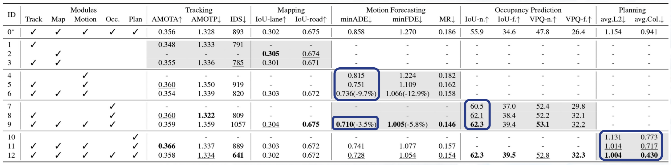
Ablation Results
Evaluation on nuScenes
01
02
Tasks benefit each other and contribute to safe planning
ID. 4-6: Track & Map → Motion
ID. 7-9: Motion ↔ Occupancy
ID. 10-12: Motion & Occupancy → Planning
03
04
The two perception sub-tasks greatly help motion forecasting, and prediction performance
UniAD outperforms naïve MTL solution
27
Notes:
ID0 is the naive MTL implementation

Slide 28
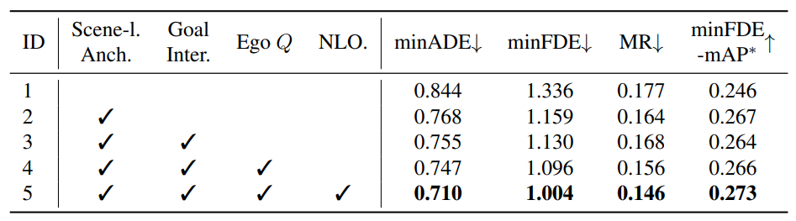
Ablation Results
Design of the MotionFormer
Non-Linear Optimization
Ego-vehicle Query
Agent-goal interaction
Rotated scene-level anchors
All components contribute to the ultimate performance
28

Slide 29
Ablation Results
Design of the OccFormer
Re-use of Mask feature (Instance-level occupancy)
Cross- and Attention mask (Pixel-level interaction)
Cross-attention with masks and the reuse of mask feature helps improve the prediction
Not all metrics show best performance…
29
Notes:
Reusing the mask feature M^t instead of the agent feature G^t to acquire the occupancy feature further enhances performance.

Slide 30
Ablation Results
Design of the Planner
Optimization strategy with Occupancy
Collision Loss
Attending to BEV feature
Results demonstrate the necessity of each preceding task
Same as in OccFormer, not all metrics improve
30

Slide 31
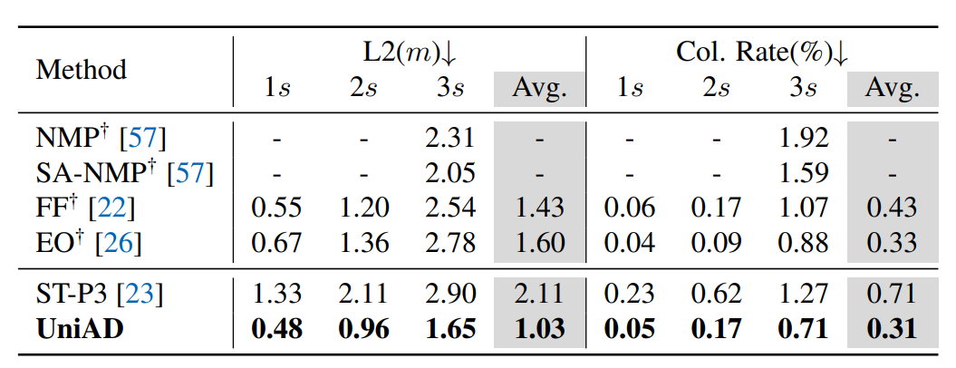
Results: Planning
LiDAR-based
camera-based
01
UniAD achieves the lowest L2 error and collision rate in all time intervals
02
UniAD outperforms LiDAR-based methods in all investigated metrics
31

Slide 32
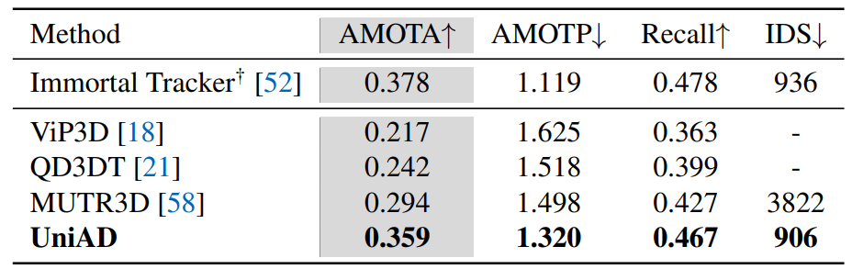
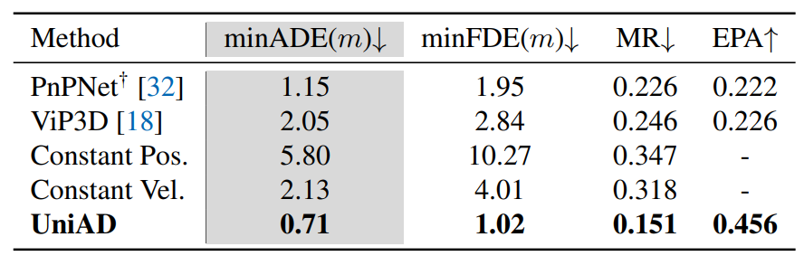
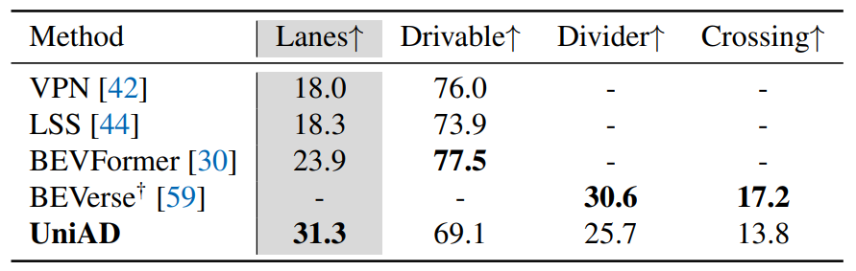
Results: Other tasks
Multi-Object Tracking
Motion Forecasting
Online Mapping
Occupancy Prediction
SOTA performance on almost all investigated tasks
32

Slide 33

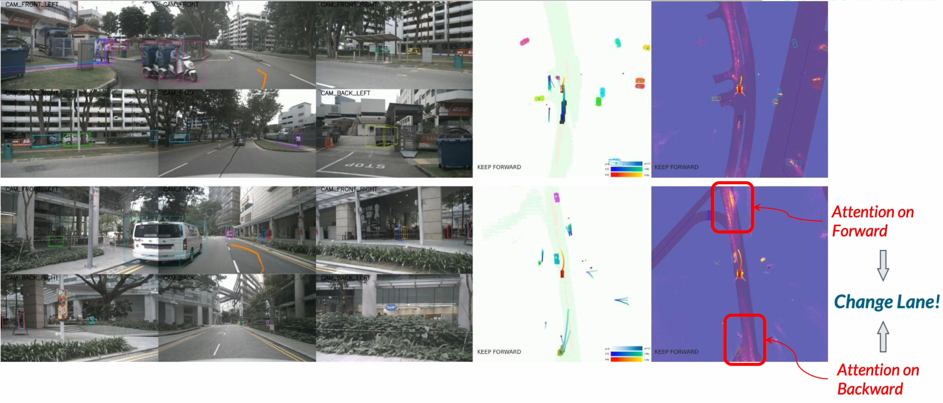
Qualitative Results
Obstacles avoidance visualization
The ego vehicle is changing lanes attentively to avoid an obstacle.
33
Notes:
In these two scenarios, the ego vehicle is changing lanes attentively to avoid the obstacle vehicle. From the attention mask, we can observe that our method focuses on the obstacles as well as the road in the front and back

Slide 34
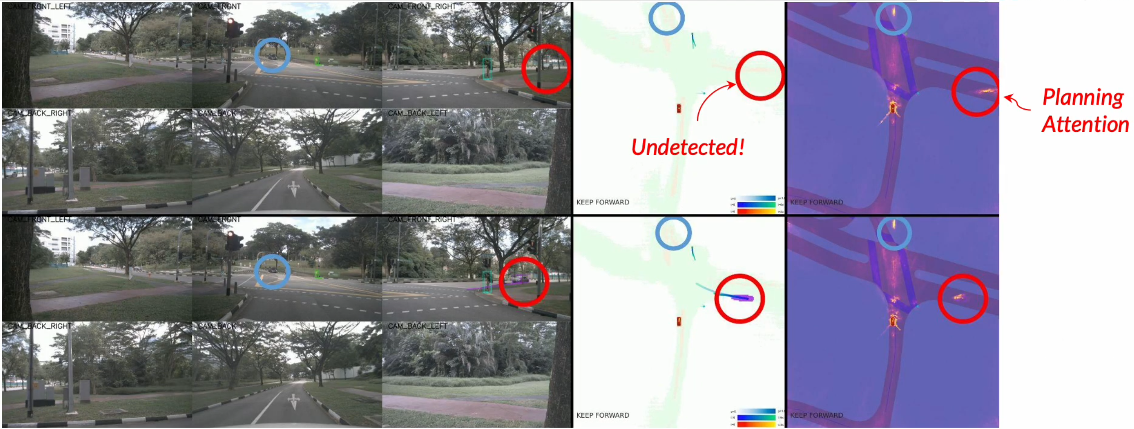
Qualitative Results
Visualization for planning recovering from perception failures
Inaccurate results occur in prior modules while the later tasks could still recover.
34
Notes:
In these two scenarios, the ego vehicle is changing lanes attentively to avoid the obstacle vehicle. From the attention mask, we can observe that our method focuses on the obstacles as well as the road in the front and back

Slide 35
II
I
III
IV
V
I
II
I
III
Table of Contents
IV
1. Motivation
2. Methodology
3. Experiment & Results
4. Limitations
5. Conclusions
II
V
III
IV
V
35

Slide 36


Limitations
Long-tail scenario
A large trailer with a white container occupies the entire road.
36
Notes:
We can observe that our tracking module fails to detect the accurate size of the front trailer and heading angles of vehicles beside the road.

Slide 37

Limitations
Over-cautious planner
Incoming vehicle in a narrow street in a dark environment.
37
Notes:
In this case, the planner is over-cautious about the incoming vehicle in the narrow street. The dark environment is one critical type of long-tail scenarios in autonomous driving. Applying smaller collision loss weight and more regulation regarding the boundary might mitigate the problem

Slide 38
Limitations: SWOT Analysis
STRENGTH
Unified end-to-end framework
Planning-oriented design
Query-based task coordination
State-of-the-Art results
WEAKNESS
Extensive computational power
Temporal history training
Limited scalability
W
S
O
T
THREAT
OPPORTUNITY
Performance in rare/dark scenarios
Simpler/more lightweight methods
LiDAR-based methods
Curation for a lightweight deployment
Integration & embedding of new tasks
(depth estimation, behaviour prediction)
38

Slide 39
II
I
III
IV
V
I
II
I
III
Table of Contents
IV
1. Motivation
2. Methodology
3. Experiment & Results
4. Limitations
5. Conclusions
II
V
III
IV
V
39

Slide 40


Conclusions – Authors’ View
Integrates perception, prediction, and planning together, reducing error propagation compared to modular approaches
Unified Query design: Queries as interfaces to connect and coordinate all tasks in an interpretable fashion
UniAD
State-of-the-art (SOTA) Performance with vision-only input
First Step towards Autonomous Driving Foundational Models
40

Slide 41
Conclusions – Authors’ View
Integrates perception, prediction, and planning together, reducing error propagation compared to modular approaches
Unified Query design: Queries as interfaces to connect and coordinate all tasks in an interpretable fashion
1
UniAD
State-of-the-art (SOTA) Performance with vision-only input
First Step towards Autonomous Driving Foundational Models
41

Slide 42
Conclusions – Authors’ View
Integrates perception, prediction, and planning together, reducing error propagation compared to modular approaches
2
Unified Query design: Queries as interfaces to connect and coordinate all tasks in an interpretable fashion
UniAD
State-of-the-art (SOTA) Performance with vision-only input
First Step towards Autonomous Driving Foundational Models
42

Slide 43
Conclusions – Authors’ View
Integrates perception, prediction, and planning together, reducing error propagation compared to modular approaches
Unified Query design: Queries as interfaces to connect and coordinate all tasks in an interpretable fashion
UniAD
3
State-of-the-art (SOTA) Performance with vision-only input
First Step towards Autonomous Driving Foundational Models
43

Slide 44
Conclusions – Authors’ View
Integrates perception, prediction, and planning together, reducing error propagation compared to modular approaches
Unified Query design: Queries as interfaces to connect and coordinate all tasks in an interpretable fashion
UniAD
4
State-of-the-art (SOTA) Performance with vision-only input
First Step towards Autonomous Driving Foundational Models
44

Slide 45
Conclusions – My View
Unified Query design: Queries as interfaces to connect and coordinate all tasks in an interpretable fashion
Some Design choices seem too abstract
Some Ablation Results are not conclusive, i.e., not all metrics are improving w.r.t features
UniAD
State-of-the-art (SOTA) Performance with vision-only input
First Step towards Autonomous Driving Foundational Models
Much to learn we still have
Better comparison against LiDAR needed
45

Slide 46
Thank you for your attention
Time for questions!
46

Slide 47
References
Carion, N., F. Massa, G. Synnaeve, N. Usunier, A. Kirillov, and S. Zagoruyko. End-to-End Object Detection with Transformers, 2020. arXiv: 2005.12872 [cs.CV]. https://arxiv.org/abs/2005.12872.
Chen, L., P. Wu, K. Chitta, B. Jaeger, A. Geiger, and H. Li. “End-to-end Autonomous Driving: Challenges and Frontiers.” IEEE Transactions on Pattern Analysis and Machine Intelligence, 2024.
Hu, Y. [CVPR2023 Award Candidate] UniAD: Planning-oriented Autonomous Driving. YouTube Video. Candidate Award Talk, available at https://www.youtube.com/watch?v=R4iuq3zDBL4, 2023.
Hu, Y. CVPR23 Plenary Talk — [Best Paper] UniAD: Planning-oriented Autonomous Driving. YouTube Video. Plenary talk at CVPR 2023, available at https://www.youtube.com/watch?v=cyrxJJ_nnaQ, 2023.
Hu, Y., J. Yang, L. Chen, K. Li, C. Sima, X. Zhu, S. Chai, et al. Planning-oriented Autonomous Driving, 2023. arXiv: 2212.10156 [cs.CV]. https://arxiv.org/abs/2212.10156.
Li, Z., W. Wang, H. Li, E. Xie, C. Sima, T. Lu, Q. Yu, and J. Dai. BEVFormer: Learning Bird’s-Eye-View Representation from Multi-Camera Images via Spatiotemporal Transformers, 2022. arXiv: 2203.17270 [cs.CV]. https://arxiv.org/abs/2203.17270.
Li, Z., W. Wang, E. Xie, Z. Yu, A. Anandkumar, J. M. Alvarez, P. Luo, and T. Lu. Panoptic SegFormer: Delving Deeper into Panoptic Segmentation with Transformers, 2022. arXiv: 2109.03814 [cs.CV]. https://arxiv.org/abs/2109.03814.
Zeng, F., B. Dong, Y. Zhang, T. Wang, X. Zhang, and Y. Wei. MOTR: End-to-End Multiple-Object Tracking with Transformer, 2022. arXiv: 2105.03247 [cs.CV]. https://arxiv.org/abs/2105.03247.
All illustrations and tables taken from the original paper: Planning-oriented Autonomous Driving (including Supplementary Material) by Hu, Y., J. Yang, L. Chen, K. Li, C. Sima, X. Zhu, S. Chai, et al., unless specified otherwise. The references listed on the tables have the enumeration from the original paper.
47

